Slide 1
UNIT 2
Process management
Dept. of CSE(CS), MSRIT

Slide 2

Process Management
Dept. of CSE(CS), MSRIT

Slide 3
Processes
Early vs. Modern Systems
Early computers executed only one program at a time, giving it full control over system resources. Modern systems allow multiple programs to reside in memory and run concurrently.
To manage multiple programs safely and efficiently, the concept of a process (a program in execution) was introduced. A process is the basic unit of work in modern time-sharing systems.
System and User Processes
A computer system consists of:
Operating system processes (execute system-level code)
User processes (execute user programs)
Both types may run concurrently.
CPU Multiplexing and Productivity
The operating system switches the CPU among multiple processes (CPU multiplexing), allowing concurrent execution and improving overall system productivity.
Dept. of CSE(CS), MSRIT

Slide 4
Process Concepts
All CPU Activities Are Called Processes
Whether it is a batch job, a user program (like a browser or word processor), or internal operating system tasks (such as memory management), all these CPU activities are similar in nature. Therefore, they are collectively referred to as processes.
Job vs. Process Terminology
The terms job and process are often used interchangeably. Historically, operating systems focused on job processing, which is why terms like job scheduling are still used, even though process is the more modern and preferred term.
Dept. of CSE(CS), MSRIT

Slide 5
Process Concept
Process: Program Under Execution
A process includes:
Text section (program code)
Program counter (address of the next instruction to execute)
CPU registers (current working state of the processor)
Stack (temporary data such as function parameters, return addresses, local variables)
Data section (global variables)
Heap (dynamically allocated memory during execution)
Dept. of CSE(CS), MSRIT

Slide 6
Anatomy of a Process in the memory
A process is much more than just the program code. It consists of several distinct parts in memory:
Text Section: The compiled program code itself.
Current Activity: Represented by the Program Counter (which tracks the next instruction to execute) and the contents of the processor's registers.
Stack: Contains temporary data, such as function parameters, return addresses, and local variables.
Data Section: Contains all the global variables used by the program.
Heap: Memory that is dynamically allocated to the process while it is running.
Dept. of CSE(CS), MSRIT

Slide 7
Program Versus Process and Multiple Instances
Passive vs. Active:
A program is a passive entity—just a file containing a list of instructions stored on a disk (an executable file).
A process is an active entity—it has a program counter and associated resources.
How it starts: A program becomes a process when the executable file is loaded into memory (e.g., by double-clicking an icon or typing the file name in a command line).
Multiple Instances:
You can run the same program multiple times (e.g., opening several web browser windows).
Each instance is a completely separate process.
While they have the exact same Text (code) section, their Data, Heap, and Stack sections are entirely separate and unique.

Slide 8
Process as Execution Environment
Meta-Processes: A process itself can serve as an execution environment for other code.
The Java Example: The Java Virtual Machine (JVM) is a perfect example of this concept.
When you run a compiled Java program (e.g., typing java Program.class), the operating system does not run the Java code directly.
Instead, the OS starts the JVM as an ordinary process.
The JVM process then interprets the loaded Java code and takes actions on behalf of that code.
Simulation: This concept is essentially the same as running a simulation, where a program acts as a virtual machine executing a different instruction set.

Slide 9
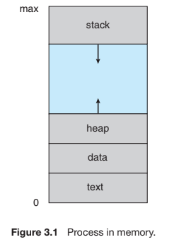
The Process
Dept. of CSE(CS), MSRIT

Slide 10
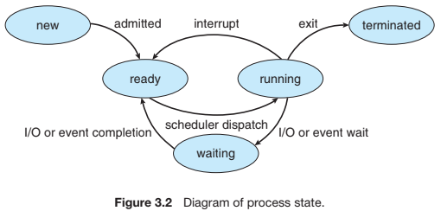
Process State
Dept. of CSE(CS), MSRIT

Slide 11
Process States and Lifecycle
Dynamic Nature of Processes: As a process executes, it changes state. The state is defined in part by the current activity of that process.
The Five Basic States:
New: The process is currently being created.
Ready: The process has everything it needs to run and is simply waiting to be assigned to a processor.
Running: Instructions are actively being executed by the CPU.
Waiting (Blocked): The process cannot continue yet; it is waiting for some event to occur (such as an I/O completion or receiving a signal).
Terminated: The process has completely finished its execution.
The Golden Rule of Processing: On any single processor (CPU core), only one process can be running at any given instant. However, many processes can be in the "Ready" and "Waiting" states at the same time.
Dept. of CSE(CS), MSRIT

Slide 12
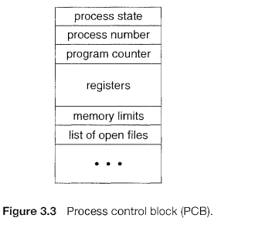
Process Control Block
Each process is represented in the operating system by a process control block (PCB)—also called a task control block. A PCB is shown in Figure 3.3.
Dept. of CSE(CS), MSRIT

Slide 13
Process Control Block
What is it? Each process is represented in the operating system by a Process Control Block (PCB), which is also called a task control block.
Purpose: The PCB serves as the central repository for any information that may vary from process to process.
Dept. of CSE(CS), MSRIT

Slide 14
Process Control Block
A PCB of each process contains following information.
Process state. The state may be new, ready, running, waiting, halted, and so on.
Program counter. The counter indicates the address of the next instruction to be executed for this process.
CPU registers. The registers vary in number and type, depending on the computer architecture. They include accumulators, index registers, stack pointers, and general-purpose registers, plus any condition-code information. Along with the program counter, this state information must be saved when an interrupt occurs, to allow the process to be continued correctly afterward.
CPU-scheduling information. This information includes a process priority, pointers to scheduling queues, and any other scheduling parameters.
Memory-management information. This information may include such items as the value of the base and limit registers and the page tables, or the segment tables, depending on the memory system used by the operating system.
Accounting information. This information includes the amount of CPU and real time used, time limits, account numbers, job or process numbers, and so on.
I/O status information. This information includes the list of I/O devices allocated to the process, a list of open files, and so on.

Slide 15
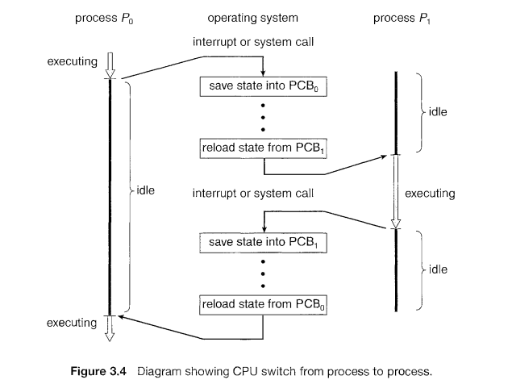
Process Control Block
Each process is represented in the operating system by a Process Control Block(PCB) or also called as Task Control Block. A PCB of each process contains following information.
Dept. of CSE(CS), MSRIT

Slide 16
Process Control Block in action
Handling Interrupts: When an interrupt or system call occurs, the operating system must temporarily stop the running process.
State Save: The system must save the current state information (specifically the program counter and CPU registers) into the process's PCB.
State Restore: This saved information allows the OS to correctly restore and continue the process later without losing any data.
The Switch Mechanism:
Process P0 is executing.
An interrupt occurs. Process P0's state is saved into PCB0.
The CPU is briefly idle while the OS selects a new process.
The state of Process P1 is reloaded from PCB1.
Process P1 begins executing.
Dept. of CSE(CS), MSRIT

Slide 17
Threads
A thread is the smallest unit of execution within a process. It represents a single sequence of instructions that can be scheduled and executed by the CPU.
In simple terms, a thread is a lightweight subprocess that allows a program (process) to perform multiple tasks concurrently.
Multiple threads within the same process share the process’s resources such as code (text section), data section, and heap, but each thread has its own program counter, registers, and stack.
For example, in a web browser, one thread may handle user input, another may load a webpage, and another may play a video—all within the same process.
Dept. of CSE(CS), MSRIT

Slide 18
Threads
Single-Threaded Process Model
Traditionally, a process was considered to have a single thread of execution, meaning it could perform only one task at a time. For example, in a word processor, the user could not type and run the spell checker simultaneously within the same process because only one sequence of instructions was executing.
Multithreaded Process Model
Modern operating systems allow a process to have multiple threads of execution, enabling it to perform multiple tasks at the same time. This is especially useful in multicore systems where threads can run in parallel. To support this, the Process Control Block (PCB) is expanded to store thread-related information, and additional system changes are required.
Dept. of CSE(CS), MSRIT

Slide 19
Process Scheduling
The goal of multiprogramming is to keep some process running at all times to maximize CPU utilization. The goal of time sharing is to switch the CPU among processes frequently so that users can interact with each program while it is running.
2. To achieve these goals, the process scheduler selects an available process for execution on the CPU. In a single-processor system, only one process can run at a time; if multiple processes exist, the others must wait until the CPU becomes free and they are rescheduled.
Multiprogramming is used to keep the CPU busy by ensuring that some process is always running.
Time sharing allows the CPU to switch between processes very quickly so that users can interact with programs while they are running.
In a single-processor system, only one process can run at a time, so the process scheduler selects one process to use the CPU while the others wait.
Dept. of CSE(CS), MSRIT

Slide 20
Scheduling Queues
When processes enter the system, they are first placed in the job queue, which contains all processes in the system. The processes that are loaded into main memory and are ready to execute are kept in the ready queue. The ready queue is generally implemented as a linked list, where the header contains pointers to the first and last Process Control Blocks (PCBs), and each PCB points to the next PCB in the queue.
This organization is illustrated in Figure 3.5. When a process is allocated the CPU, it executes until it terminates, is interrupted, or waits for an event such as I/O completion. If the process requests an I/O device (for example, a disk) and the device is busy, it must wait in the corresponding device queue. Each I/O device has its own device queue that holds processes waiting for that device, as shown in Figure 3.5.
Dept. of CSE(CS), MSRIT

Slide 21
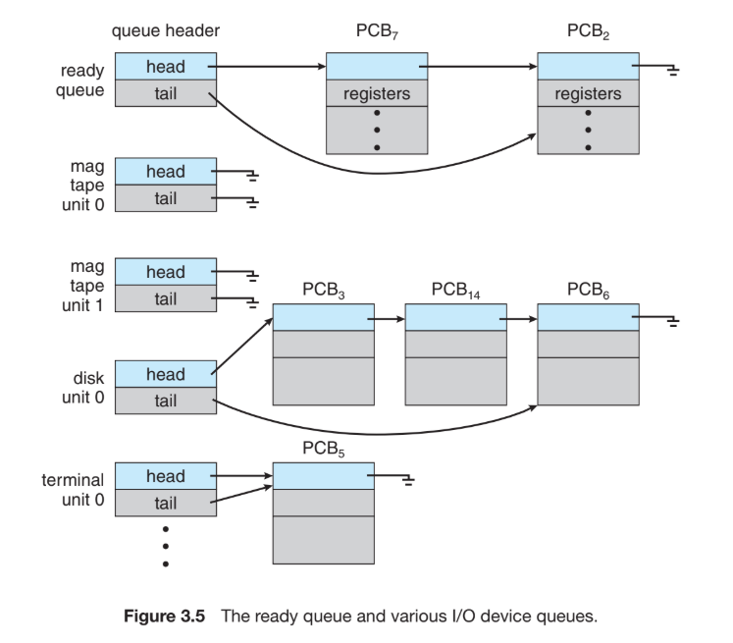
Ready Queue and Various I/O Device Queues Scheduling Queues

Slide 22
Scheduling Queues
Process scheduling is commonly illustrated using a queueing diagram (Figure 3.6), where each rectangular box represents a queue. The two types of queues shown are the ready queue and multiple device queues.
A new process is initially put in the ready queue. It waits there until it is selected for execution, or dispatched. Once the process is allocated the CPU and is executing, one of several events could occur:
• The process could issue an I/O request and then be placed in an I/O queue.
• The process could create a new child process and wait for the child’s termination.
• The process could be removed forcibly from the CPU, as a result of an interrupt, and be put back in the ready queue.
In the first two cases, the process eventually switches from the waiting state to the ready state and is then put back in the ready queue. A process continues this cycle until it terminates, at which time it is removed from all queues and has its PCB and resources deallocated.

Slide 23
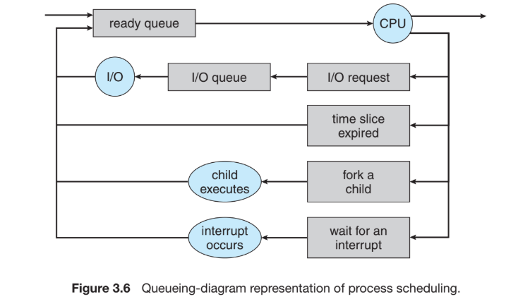
Representation of Process Scheduling
Dept. of CSE(CS), MSRIT

Slide 24
Schedulers
LongTerm Scheduler
As a process migrates among scheduling queues, the OS must select which processes run next using schedulers.
Long-Term Scheduler (Job Scheduler):
Selects processes from a mass-storage pool (disk) and loads them into memory.
Executes infrequently (minutes apart) and controls the degree of multiprogramming (the total number of processes in memory).
Because it runs less frequently, it can afford to take more time to make careful scheduling decisions.
Short Term Scheduler(Cpu Scheduler)
Selects from processes already in memory (ready queue) and allocates the CPU to one of them.
Executes very frequently (e.g., at least once every 100 milliseconds).
Because of its frequency, it must be incredibly fast to avoid wasting CPU time on overhead.
Dept. of CSE(CS), MSRIT

Slide 25
Schedulers
Medium Term Scheduler
The Problem: Sometimes an operating system becomes overcommitted, or the process mix needs to be improved.
The Solution: An intermediate level of scheduling called the Medium-Term Scheduler.
How it Works (Swapping):
It removes a process from memory (and from active contention for the CPU), thereby reducing the degree of multiprogramming.
The process is swapped out to a storage disk.
Later, the process is swapped in (reintroduced into memory), and its execution continues exactly where it left off.
Dept. of CSE(CS), MSRIT

Slide 26
Schedulers
A process migrates among the various scheduling queues throughout its ifetime. The operating system must select, for scheduling purposes, processes from these queues in some fashion. The selection process is carried out by the appropriate scheduler.
The long-term scheduler (job scheduler) selects processes from this pool and loads them into memory. The short-term scheduler executes less frequently.
The short-term scheduler (CPU scheduler) selects from the ready processes in memory and allocates the CPU to one of them. The short-term scheduler must select a new process for the CPU frequently.
An I/O-bound process is one that spends more of its time doing I/O than it spends doing computations.
A CPU-bound process, in contrast, generates I/O requests infrequently, using more of its time doing computations.
Dept. of CSE(CS), MSRIT

Slide 27
Process Mix and System Balancing
The Goal of the Long-Term Scheduler: To select a good "mix" of processes to keep the system balanced.
Two Types of Processes:
I/O-Bound Process: Spends more of its time doing I/O than doing computations.
CPU-Bound Process: Generates I/O requests infrequently, using more of its time doing heavy computations.
Why the Mix Matters:
If all processes are I/O bound → CPU ready queue is empty, short-term scheduler has nothing to do.
If all processes are CPU bound → I/O queues are empty, devices go unused.
Modern Systems: In time-sharing systems like UNIX and Windows, the long-term scheduler is often minimal or absent. They simply put every new process directly into memory for the short-term scheduler.
Dept. of CSE(CS), MSRIT

Slide 28
Schedulers
The medium-term scheduler is responsible for swapping processes in and out of memory.
It works between the long-term and short-term schedulers.
When the system is overloaded (too many processes in RAM), it:
Selects some processes
Suspends them
Moves them to secondary storage (disk)
Brings them back later when memory is available.
Dept. of CSE(CS), MSRIT

Slide 29
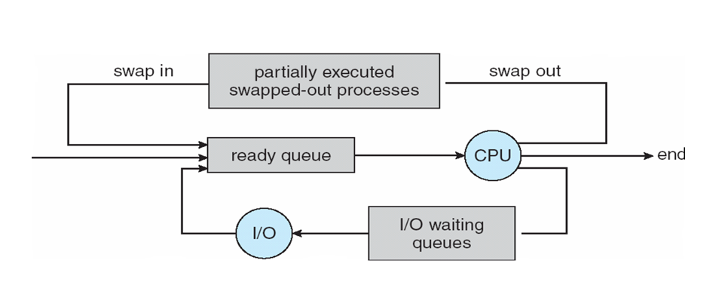
Schedulers
The medium-term scheduler temporarily removes processes from memory to reduce the degree of multiprogramming and free CPU and memory resources; this process is called swapping. The process is swapped out, and is later swapped in, by the medium-term scheduler. Swapping may be necessary to improve the process mix or because a change in memory requirements has overcommitted available memory, requiring memory to be freed up.
Dept. of CSE(CS), MSRIT

Slide 30
Context Switch
In an operating system, interrupts frequently occur and cause the CPU to stop its current task and transfer control to a kernel routine for handling the interrupt.
During an interrupt, the operating system must save the current execution context of the running process so that it can later resume execution correctly after the interrupt is handled.
This execution context is stored in the Process Control Block (PCB) and includes the CPU register values, the process state, and memory-management information.
When the CPU is switched from one process to another, the system performs a context switch, which involves saving the state of the old process and restoring the state of the new process.
Context switching introduces overhead, as the system performs no useful work during the switch; the time required depends on hardware features such as memory speed, register count, and special instructions, and typically takes a few milliseconds.
The efficiency of a context switch is highly dependent on hardware and operating system complexity; processors with multiple register sets switch faster, while advanced memory-management techniques require additional context information to be saved and restored.
Dept. of CSE(CS), MSRIT

Slide 31
Operations on Processes
The processes in most systems can execute concurrently, and they may be created and deleted dynamically. Thus, these systems must provide a mechanism for process creation and termination.
Dept. of CSE(CS), MSRIT

Slide 32
Process Creation
Parent and Child Processes: During execution, a process can create several new processes.
The creator is the parent process.
The new processes are the children.
Because children can create their own children, this forms a massive tree of processes.
Process Identifier (PID): Most operating systems (UNIX, Linux, Windows) identify every single process using a unique integer called a pid. The OS uses this pid as an index to look up the process's attributes.
Dept. of CSE(CS), MSRIT

Slide 33
Operations on Process-Process Creation
During execution, a process can create new processes.
The original process is called the parent process.
The newly created processes are called child processes.
Every process in an operating system is uniquely identified by a process identifier (PID), usually an integer. Operating systems like UNIX, Windows, and Solaris use PIDs to manage and track processes.
On UNIX and Linux systems, we can obtain a listing of processes by using the ps command. For example, the command
ps -el
will list complete information for all processes currently active in the system.
Dept. of CSE(CS), MSRIT

Slide 34
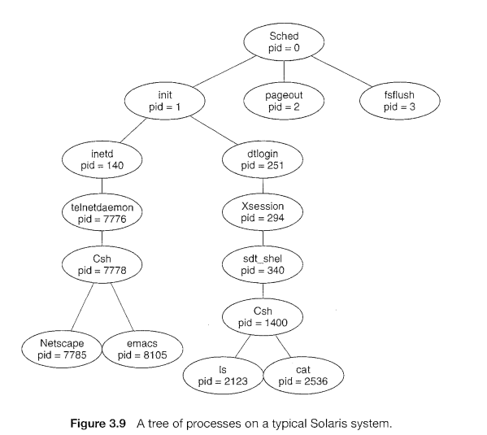
Process Creation
Dept. of CSE(CS), MSRIT

Slide 35
Process Tree
The Linux Process Tree Example:
The init process (pid = 1) serves as the ultimate root parent for all user processes.
Once the system boots, init spawns tasks like web servers, print servers, or the login screen.
Command: On UNIX/Linux, typing ps -el in the terminal will list complete information for all currently active processes.
Dept. of CSE(CS), MSRIT

Slide 36
Process Creation
In general, when a process creates a child process, that child process will need certain resources (CPU time, memory, files, I/O devices) to accomplish its task.
A child process may be able to obtain its resources directly from the operating system, or it may be constrained to a subset of the resources of the parent process.
The parent may have to partition its resources among its children, or it may be able to share some resources (such as memory or files) among several of its children.
Passing initialization data to child processes:-Parent processes can pass initialization data (such as file names or output devices) to child processes. Some systems pass open files, allowing the child to directly transfer data between resources.
For example, consider a process whose function is to display the contents of a file-say, img.jpg-on the screen of a terminal. When it is created, it will get, as an input from its parent process, the name of the file img.jpg, and it will use that file name, open the file, and write the contents out. It may also get the name of the output device.

Slide 37
Process Creation
Process creation using fork()
In UNIX, each process has a unique process identifier (PID). A new process is created using the fork() system call, which creates a child process by copying the parent’s address space. Both parent and child continue execution from the instruction following fork().
Return values and parent–child distinction
After fork(), the child process receives a return value of 0, while the parent receives the PID of the child (a nonzero value). This return value allows the program to distinguish between parent and child processes.
Program replacement using exec()
Typically, one of the processes (usually the child) calls the exec() system call to replace its memory space with a new program. The exec() call loads a new binary file (such as /bin/ls) into memory, destroying the old program image and starting execution of the new program.
Process synchronization using wait() and termination
The child process inherits resources and privileges from the parent and executes the new program. The parent process may call wait() to suspend execution until the child finishes. When the child terminates using exit(), the parent resumes and eventually completes its execution.
Dept. of CSE(CS), MSRIT

Slide 38
Process Creation
When a process creates a new process, two possibilities for execution exist:
1. The parent continues to execute concurrently with its children.
2. The parent waits until some or all of its children have terminated.
There are also two address-space possibilities for the new process:
1. The child process is a duplicate of the parent process (it has the same program and data as the parent).
2. The child process has a new program loaded into it.
Dept. of CSE(CS), MSRIT

Slide 39
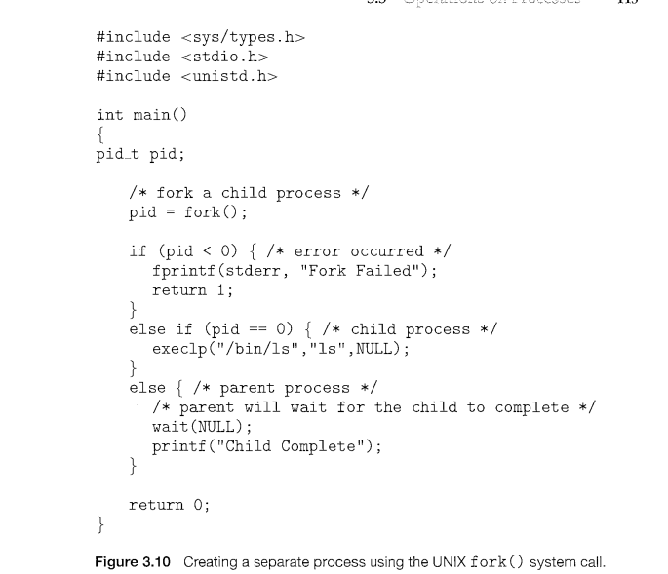
C Program Forking Separate Process

Slide 40
Process Creation
Process listing and monitoring:-In UNIX, the ps command (e.g., ps -el) is used to list active processes. A process tree can be constructed by tracing parent processes back to the init process.
Resource allocation and control:-Processes require resources such as CPU time, memory, files, and I/O devices. Child processes may obtain resources directly from the operating system or inherit a subset of the parent’s resources. Resource sharing and partitioning help prevent system overload.
Passing initialization data to child processes:-Parent processes can pass initialization data (such as file names or output devices) to child processes. Some systems pass open files, allowing the child to directly transfer data between resources.
Execution behavior and address space (UNIX fork):After creation, the parent may execute concurrently with the child or wait for its termination. In UNIX, the fork() system call creates a child process that is a duplicate of the parent’s address space; both continue execution, with the child receiving a return value of 0 and the parent receiving the child’s PID.
Dept. of CSE(CS), MSRIT

Slide 41
Process Creation
Process creation and hierarchy:-
A process can create multiple new processes during its execution using a create-process system call. The creating process is called the parent, and the newly created ones are children. Repeated creation forms a hierarchical process tree.
Process identification using PID:-
Every process in an operating system is uniquely identified by a process identifier (PID), usually an integer. Operating systems like UNIX, Windows, and Solaris use PIDs to manage and track processes.
Process tree example in Solaris:
In Solaris, the root of the process tree is the sched process (PID 0), which creates system processes such as pageout and fsflush for memory and file-system management. It also creates the init process, the parent of all user processes.
User processes and shells: -The init process creates services like inetd (network services) and dtlogin (login manager). User login leads to the creation of sessions and shells (such as csh), which further create child processes like commands and applications.
Dept. of CSE(CS), MSRIT

Slide 42
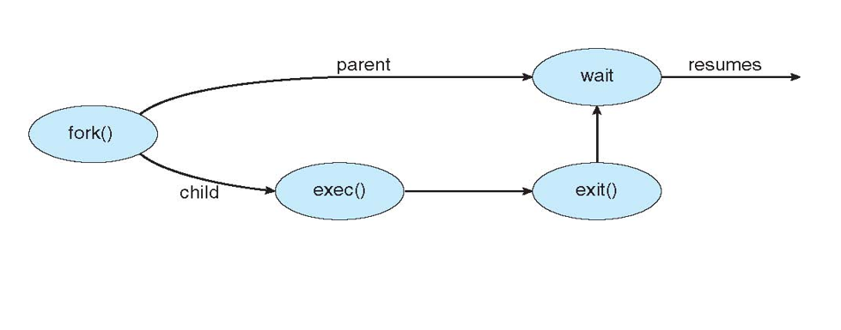
Process Creation
Dept. of CSE(CS), MSRIT

Slide 43
Process Creation in Windows
Unlike the "copy-paste" nature of UNIX fork(), Windows uses a direct creation approach.
There is no cloning; a process is born as a new entity with its own executable right from the start.
Key Differences: Windows vs. UNIX
No Cloning: CreateProcess() loads a specific program into the child’s address space immediately.
Parameter Complexity: * UNIX fork() = 0 parameters.
Windows CreateProcess() = 10 parameters.
Dept. of CSE(CS), MSRIT

Slide 44
Process Creation in Windows
The Anatomy of CreateProcess()
Application & Command Line: Defines what to run
Security & Inheritance: Middle parameters handle process/thread handles and environment blocks.
The Structures: The final two parameters are pointers to:
STARTUPINFO: Window appearance and handles.
PROCESS_INFORMATION: Receives identification handles for the new child.
Waiting for the Child
To synchronize, Windows uses WaitForSingleObject() instead of wait().
Mechanism: The parent uses the hProcess handle from the PROCESS_INFORMATION structure.
Result: The parent "pauses" until the child signals it has finished.

Slide 45
Process Termination
Normal process termination
A process terminates by calling the exit() system call after completing execution. It may return a status value to its parent through the wait() system call, and the operating system deallocates all resources such as memory, open files, and I/O buffers.
Termination by another process
A process can also be terminated by another process using a system call (e.g., TerminateProcess() in Win32), usually only by its parent. To enable this, the parent is informed of the child’s identity when the process is created.
Dept. of CSE(CS), MSRIT

Slide 46
Process Termination
A parent may terminate the execution of one of its children for a variety of reasons, such as these:
The child has exceeded its usage of some of the resources that it has been allocated. (To determine whether this has occurred, the parent must have a mechanism to inspect the state of its children.)
The task assigned to the child is no longer required.
The parent is exiting, and the operating system does not allow a child to continue if its parent terminates.
Dept. of CSE(CS), MSRIT

Slide 47
Process Termination
Reasons a Parent Terminates a Child:
The child has exceeded its usage of allocated resources.
The task assigned to the child is no longer required.
The parent is exiting, and the OS does not allow a child to continue without a parent.
Cascading Termination: A phenomenon initiated by the OS in certain systems: if a parent process terminates (normally or abnormally), then all of its children must also be terminated.
Dept. of CSE(CS), MSRIT

Slide 48
Zombie Process
The wait() System Call: A parent process uses wait() to pause its own execution until a child terminates, allowing the parent to collect the child's exit status and PID.
Zombie Process: A process that has terminated, but its parent has not yet called wait().
Its resources are deallocated, but its process table entry remains to hold the exit status.
All processes become zombies briefly. The entry is released once the parent finally calls wait().
Dept. of CSE(CS), MSRIT

Slide 49
Orphan Process
Orphan Process: A child process whose parent has terminated without invoking wait().
Handling Orphans (Linux/UNIX):
The OS solves this by assigning the init process (the root of the process tree, PID 1) as the new parent to the orphan.
The init process periodically calls wait() to collect exit statuses and clean up the process table.
Dept. of CSE(CS), MSRIT

Slide 50
Inter Process Communication(IPC)
Processes executing concurrently in the operating system may be either independent processes or cooperating processes.
A process is independent if it cannot affect or be affected by the other processes executing in the system.
Any process that does not share data with any other process is independent.
A process is cooperating if it can affect or be affected by the other processes executing in the system.
Cooperating processes need interprocess communication (IPC)
Dept. of CSE(CS), MSRIT

Slide 51
Inter Process Communication(IPC)
There are several reasons for providing an environment that allows process cooperation:
Information sharing. Since several users may be interested in the same piece of information (for instance, a shared file), we must provide an environment to allow concurrent access to such information.
Computation speedup. If we want a particular task to run faster, we must break it into subtasks, each of which will be executing in parallel with the others. Notice that such a speedup can be achieved only if the computer has multiple processing elements (such as CPUs or I/O channels).
Modularity. We may want to construct the system in a modular fashion, dividing the system functions into separate processes or threads.
Convenience. Even an individual user may work on many tasks at the same time. For instance, a user may be editing, printing, and compiling in parallel. Cooperating processes require an interprocess communication (IPC) mechanism that will allow them to exchange data and information.
Dept. of CSE(CS), MSRIT

Slide 52
Inter Process Communication(IPC)
Two models of interprocess communication (IPC):
There are two fundamental IPC models: shared memory, where processes communicate by reading and writing to a common memory region, and message passing, where processes communicate by exchanging messages.
Message passing is easier to implement and is suitable for exchanging small amounts of data. It avoids conflicts and is especially useful for communication between different systems.
Shared memory provides faster and more efficient communication because, after setup, processes access memory directly without kernel intervention, making it faster than message passing.
Dept. of CSE(CS), MSRIT

Slide 53
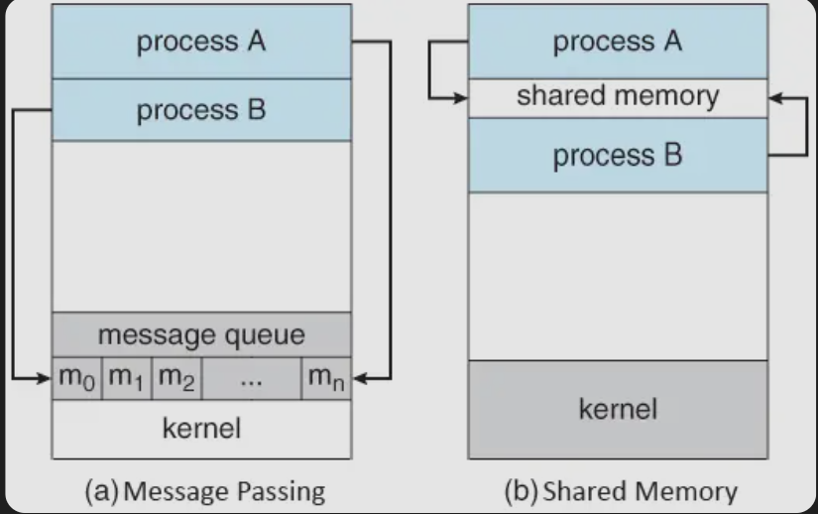
Inter Process Communication(IPC)-Communication models
Fig 3.12 Communications models a)Message Passing b) Shared Memory
Dept. of CSE(CS), MSRIT

Slide 54
Shared Memory
In shared-memory interprocess communication, a process first creates a shared-memory region within its address space. Other processes that want to communicate must attach this shared-memory segment to their own address spaces. Normally, the operating system prevents one process from accessing another process’s memory, but shared memory requires the processes to mutually agree to remove this restriction.
Data exchange and synchronization responsibility
Once shared memory is established, processes communicate by reading and writing data in the shared region. The structure, format, and location of the data are decided by the processes themselves and not controlled by the operating system. The processes must also ensure proper synchronization so that they do not write to the same memory location at the same time.
Dept. of CSE(CS), MSRIT

Slide 55
Shared Memory-Producer Consumer problem
The producer–consumer problem is a classic example of cooperating processes in an operating system. A producer process generates data items, and a consumer process consumes those items. Both processes run concurrently and must coordinate their actions while sharing data.
Example 1:
Consider a web server system:
The server (producer) generates HTML pages and images.
The web browser (consumer) receives and displays them.
Example 2:
A compiler produces assembly code → consumed by an assembler.
The assembler produces object code → consumed by the loader.
Dept. of CSE(CS), MSRIT

Slide 56
Shared Memory-Producer Consumer problem
If the producer generates data too fast, the storage area may overflow.
If the consumer tries to consume data that is not yet produced, it leads to errors.
Hence, coordination and synchronization are required.
One solution to the producer–consumer problem is shared memory.
A buffer is created in a shared memory region accessible to both producer and consumer.
The producer places items into the buffer.
The consumer removes items from the buffer.
This allows both processes to execute concurrently, improving efficiency.
Dept. of CSE(CS), MSRIT

Slide 57
Shared Memory-Producer Consumer problem
Unbounded Buffer: In the unbounded buffer approach:
There is no practical limit on the size of the buffer.
The producer can always produce new items.
The consumer may have to wait if the buffer is empty.
This model is simpler conceptually but impractical in real systems due to memory limitations.
Bounded Buffer: In the bounded buffer approach:
The buffer has a fixed size.
The producer must wait if the buffer is full.
The consumer must wait if the buffer is empty.
This model is widely used in operating systems because it reflects real-world memory constraints.
Dept. of CSE(CS), MSRIT

Slide 58
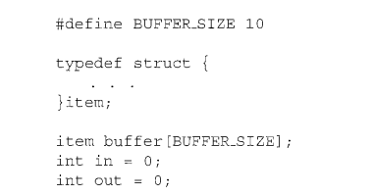
Shared Memory-Producer Consumer problem
Bounded Buffer Implemented as a circular array
in -points to the next empty position for the producer
out- points to the next item to be consumed
Buffer empty when in == out
Buffer full when ((in + 1) % BUFFER_SIZE) == out
Dept. of CSE(CS), MSRIT

Slide 59
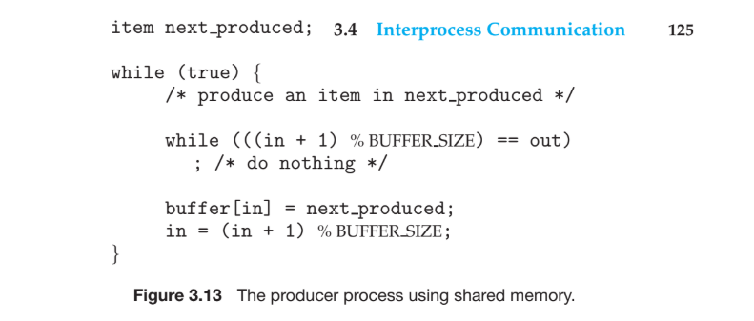
Bounded Buffer-producer
Dept. of CSE(CS), MSRIT

Slide 60
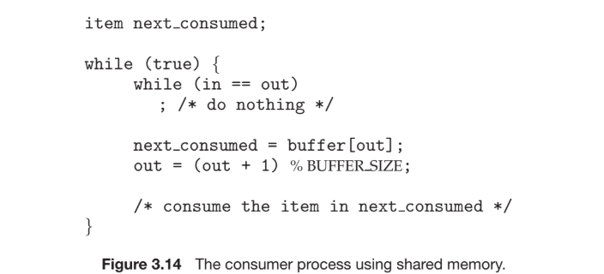
Bounded Buffer-Consumer
The given illustration does not address concurrent access to the shared buffer. If the producer and consumer access shared memory simultaneously, race conditions may occur. Therefore, synchronization mechanisms such as semaphores or mutex locks are required to ensure mutual exclusion.
Dept. of CSE(CS), MSRIT

Slide 61
Message passing
Message passing allows processes to communicate and synchronize without sharing the same address space, making it especially useful in distributed systems. Communication is done using two basic operations: send(message) and receive(message).
Messages may be of fixed or variable size. Fixed-size messages are easier to implement at the system level but harder to use for programming, while variable-size messages simplify programming but require more complex system-level implementation.
For processes to communicate, a logical communication link must exist between them. Message passing can be implemented using different logical methods, such as direct or indirect communication, synchronous or asynchronous communication, and automatic or explicit buffering.
Dept. of CSE(CS), MSRIT

Slide 62
Message passing
Three Major Design Choices: When OS designers create a send()/receive() facility, they must choose how to implement the link:
Naming
Synchronization
Buffering
Dept. of CSE(CS), MSRIT

Slide 63
Message passing--Naming
Processes that wish to communicate must be able to refer to each other. This can be achieved using either direct communication or indirect communication mechanisms.
Direct communication mechanism:- In direct communication, processes explicitly name the sender or receiver. Communication is carried out using primitives.
send(P, message) – sends a message to process P
receive(Q, message) – receives a message from process Q
In this direct communication: communication links are automatically established, are associated with exactly two processes, and only one link exists between each pair of communicating processes.
Dept. of CSE(CS), MSRIT

Slide 64
Message passing--Naming
Direct communication can be symmetric, where both sender and receiver name each other, or asymmetric, where only the sender names the receiver and the receiver accepts messages from any sender.
send(P, message)
receive(id, message) where id is set to the sender’s identity
Both symmetric and asymmetric direct communication suffer from poor modularity. Changing a process identifier requires updating all references, making hard-coded identifiers undesirable.
In indirect communication, messages are exchanged through mailboxes (ports). A mailbox is an object with a unique identifier (such as A). Processes communicate only if they share the same mailbox.
Dept. of CSE(CS), MSRIT

Slide 65
Message passing--Naming
Indirect Communication Primitives:
send(A, message) – sends a message to mailbox A
receive(A, message) – receives a message from mailbox A
Properties of mailbox-based communication: A mailbox can be shared by more than two processes. For example, processes P1, P2, and P3 may all share mailbox A, and multiple communication links may exist via different mailboxes.
Message delivery when multiple receivers exist (P1, P2, P3): If P1 sends a message to mailbox A and both P2 and P3 execute receive(A, message), the system decides which process receives the message. This may be handled by restricting receivers, allowing only one receiver at a time, or using system-defined algorithms such as round-robin.
Mailbox ownership (process-owned vs OS-owned):A mailbox may be owned by a process or by the operating system. If a process-owned mailbox terminates, the mailbox is destroyed. OS-owned mailboxes exist independently, and the OS provides system calls to create, send, receive, delete mailboxes, and transfer ownership or receiving privileges.
Dept. of CSE(CS), MSRIT

Slide 66
Multiple receiver problem
The OS Solutions: The answer depends on which method the operating system designers choose to implement:
Limit Links: Allow a link to be associated with two processes at most (preventing the scenario entirely).
Enforce Turns: Allow at most one process at a time to successfully execute a receive() operation.
System Selection: Allow the OS to arbitrarily select who gets the message (e.g., using a round-robin algorithm where processes take turns). The system may then notify the sender about who received it.
Dept. of CSE(CS), MSRIT

Slide 67
Message passing--Synchronization
Communication between processes is carried out using the send() and receive() primitives. These primitives can be implemented as either blocking (synchronous) or nonblocking (asynchronous).
Blocking send. The sending process is blocked until the message is received by the receiving process or by the mailbox.
Blocking receive. The receiver blocks until a message is available.
Nonblocking send. The sending process sends the message and resumes operation.
Nonblocking receive. The receiver retrieves either a valid message or a null.
Dept. of CSE(CS), MSRIT

Slide 68
Message passing--Buffering
Whether communication is direct or indirect, messages exchanged by communicating processes reside in a temporary queue. Basically, such queues can be implemented in three ways:
Zero capacity. The queue has a maximum length of zero; thus, the link cannot have any messages waiting in it. In this case, the sender must block until the recipient receives the message.
Bounded capacity. The queue has finite length n; thus, at most n messages can reside in it. If the queue is not full when a new message is sent, the message is placed in the queue (either the message is copied or a pointer to the message is kept), and the sender can continue execution without waiting. The link's capacity is finite, however. If the link is full, the sender must block until space is available in the queue.
Unbounded capacity. The queue's length is potentially infinite; thus, any number of messages can wait in it. The sender never blocks.
The zero-capacity case is sometimes referred to as a message system with no buffering; the other cases are referred to as systems with automatic buffering.
Dept. of CSE(CS), MSRIT

Slide 69
Shared Memory and Message passing
Feature | Shared Memory | Message Passing
Mechanism | Processes share a common region of physical memory. | Processes communicate by sending and receiving packets of data.
Kernel Involvement | Only required to establish the memory region. Subsequent access is direct. | Required for every exchange (via system calls like send() and receive()).
Speed | Faster; data transfer occurs at memory speeds without overhead. | Slower; incurs kernel intervention and context switching overhead.
Data Volume | Ideal for exchanging large amounts of data. | Best for smaller amounts of data.
Ease of Use | Harder to manage; requires manual synchronization (e.g., semaphores) to avoid conflicts. | Easier to implement; synchronization is often handled by the messaging protocol.
Environment | Best for local systems (single machine). | Essential for distributed systems (across a network).
Modern Issue | Cache Coherency: Shared data migrating between different core caches can cause performance lags. | Overhead: Frequent system calls can create a bottleneck for high-frequency messaging.
Dept. of CSE(CS), MSRIT

